Slide 1
FINGENIE AI
Presented by :AISHWARYA M
Trainer Name: Mr. JAVEED

Slide 2
Introduction: FinGenie AI is a smart banking application that helps users to manage accounts, transaction, loans, and fraud detection through AI driven features. Objectives: Secure Banking User Management Transaction Monitoring Fraud Detection Loan Management

Slide 3
Technology: Frontend: React JS Bootstrap CSS Backend: Spring Boot REST API DTO Architecture Database: MySQL

Slide 4
System Architecture: Architecture Flow User->React Frontend->RESTAPI->Spring Boot Backend ->MYSQL Database Modules 1.Authentication 2.Account Management 3.Transaction Management 4.Loan Management 5.Fraud Detection 6.Admin Dashboard

Slide 5
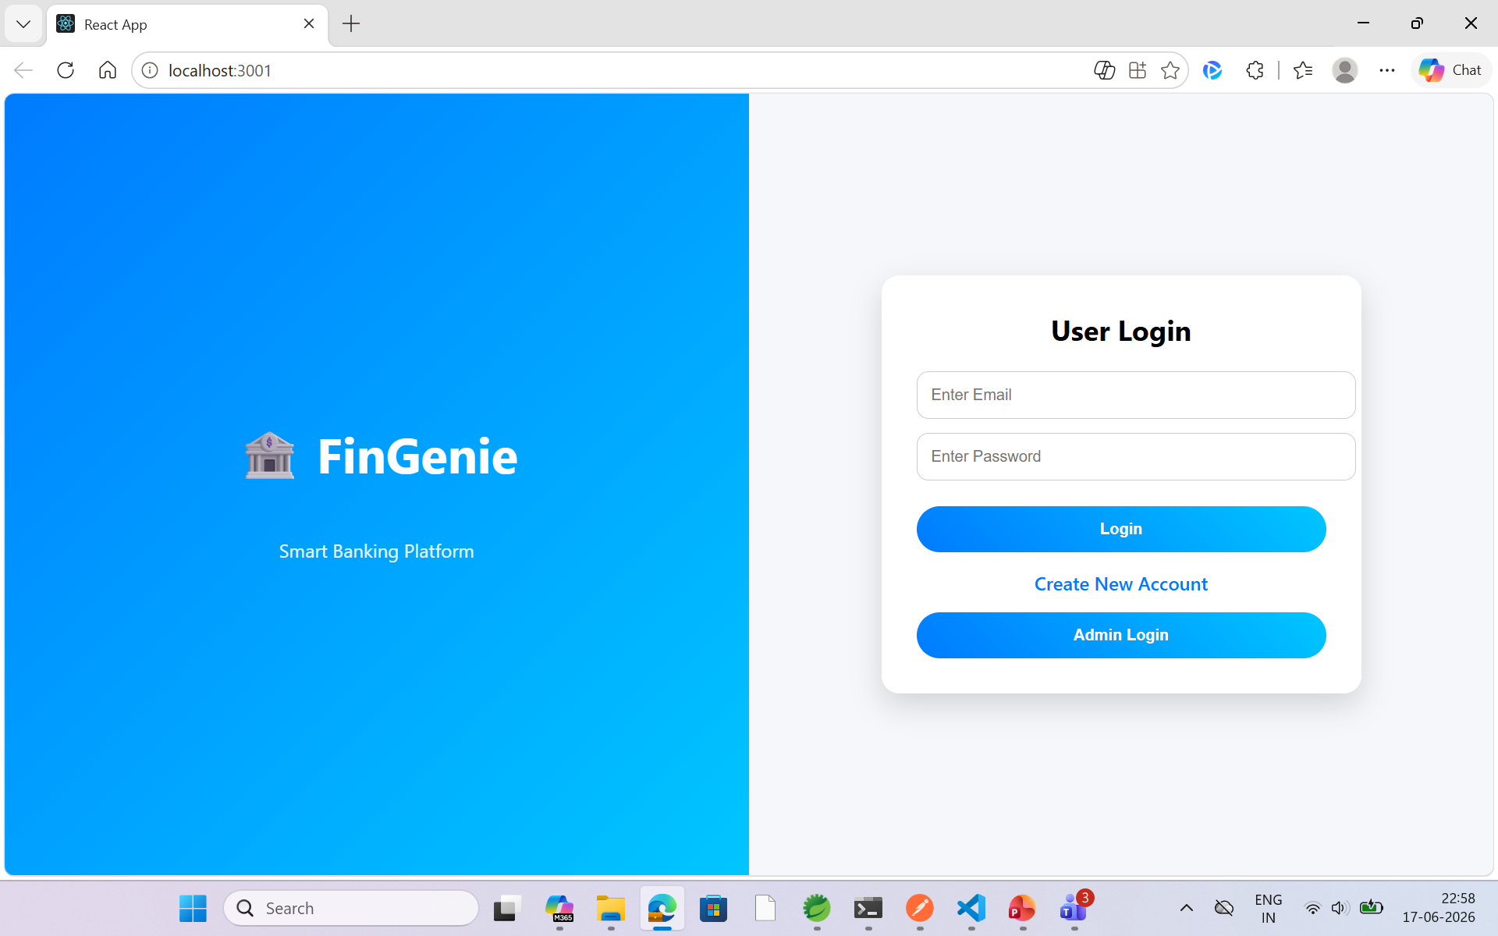
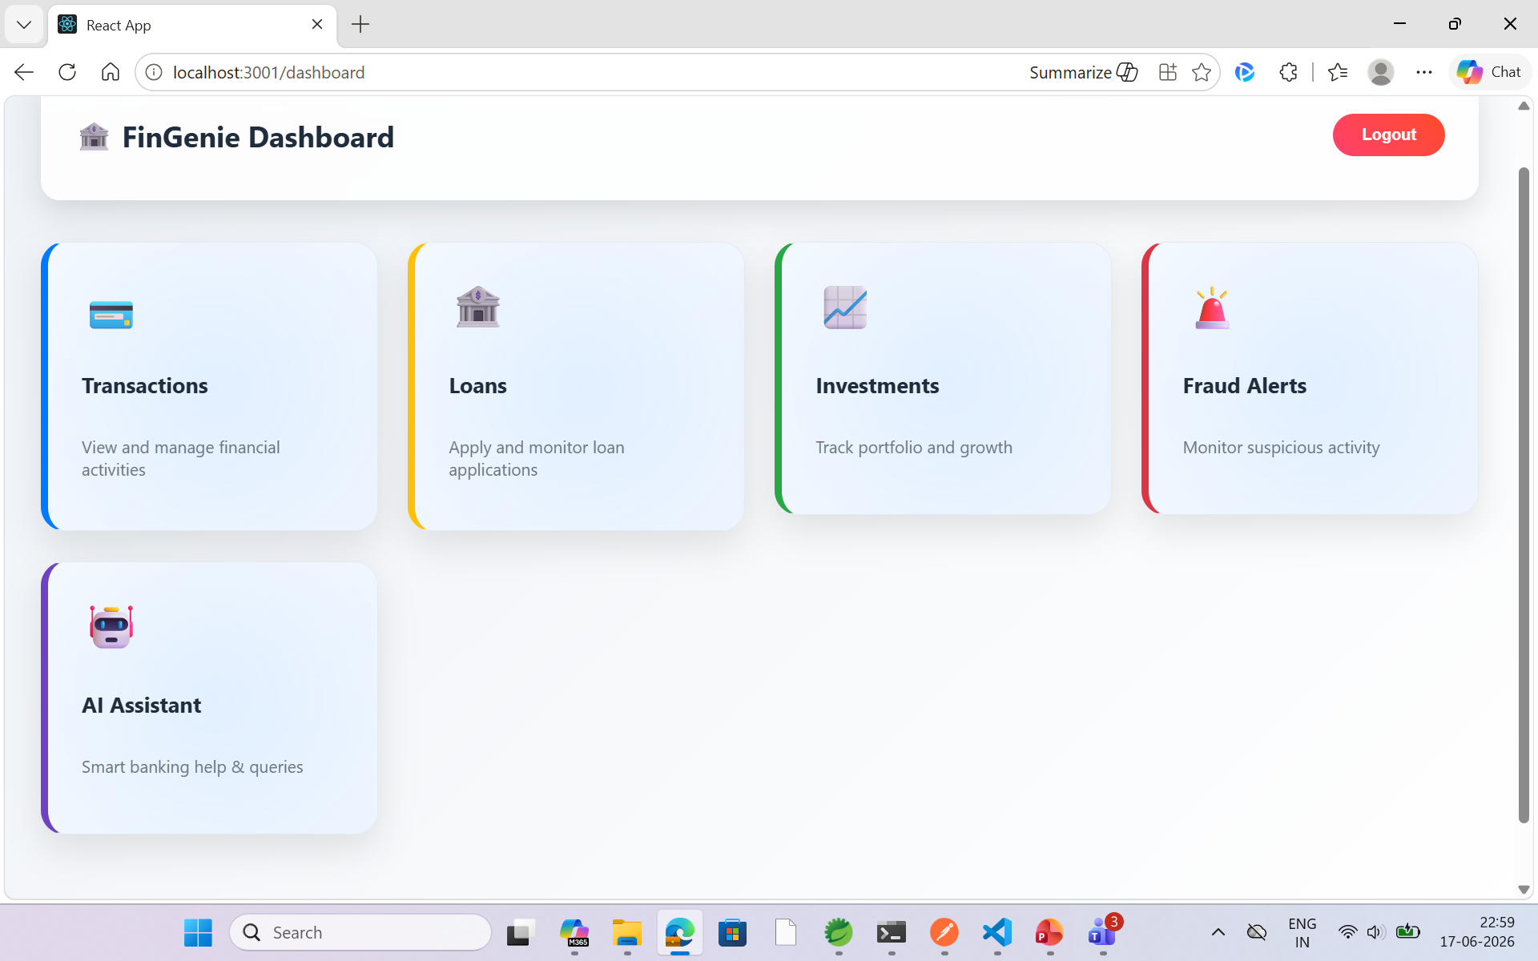
User Login Page User Dashboard
Screenshots:

Slide 6
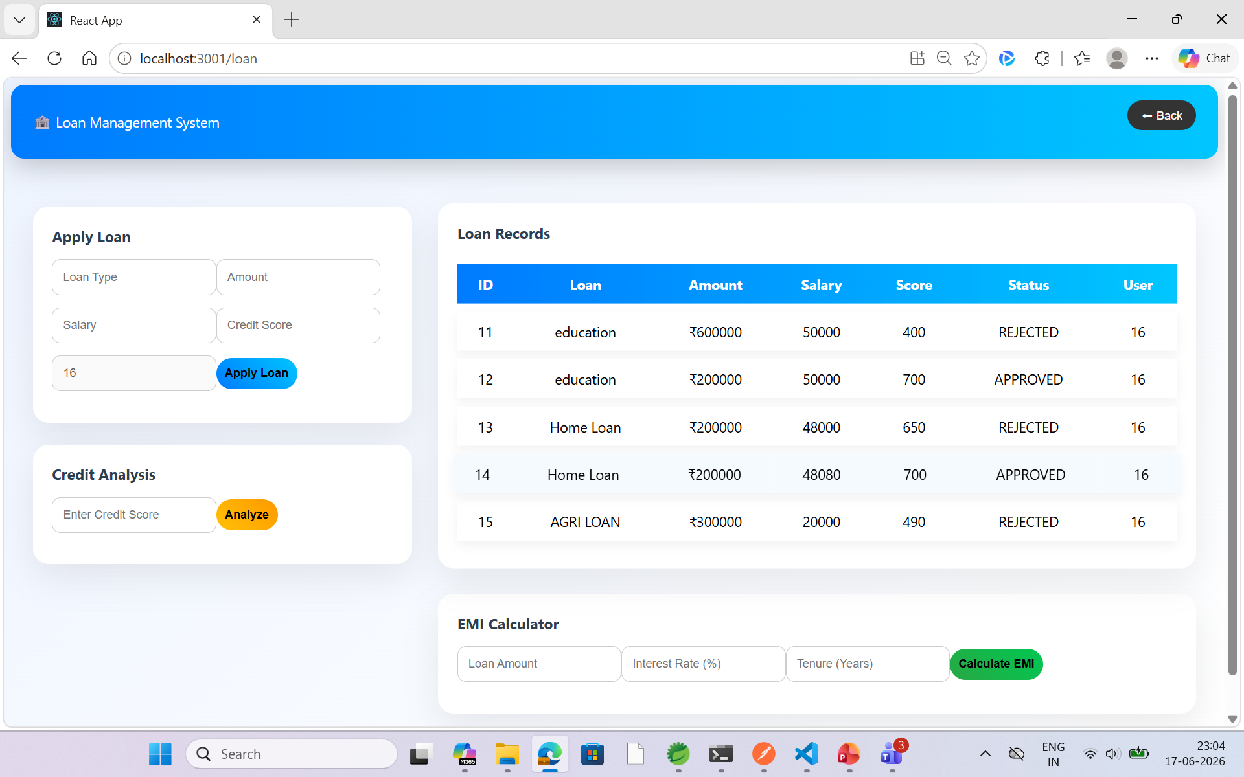
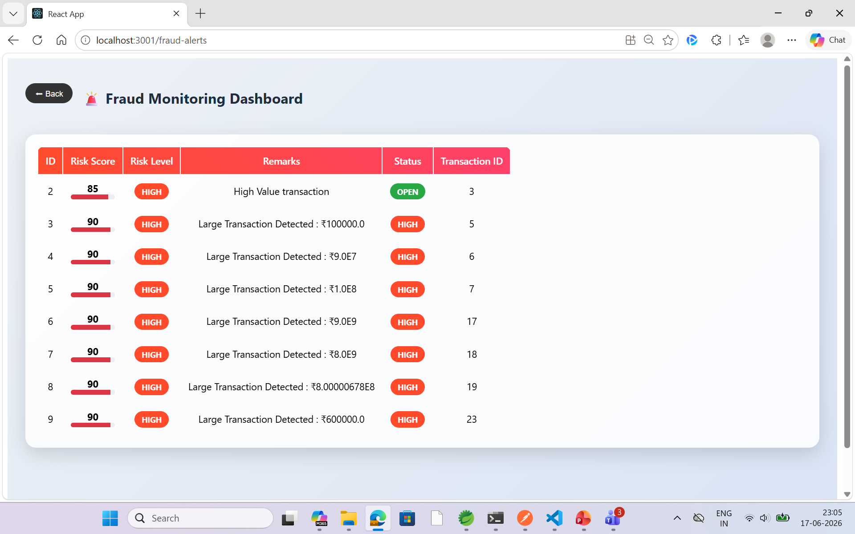
Loan Management Page Fraud Monitoring Dashboard

Slide 7
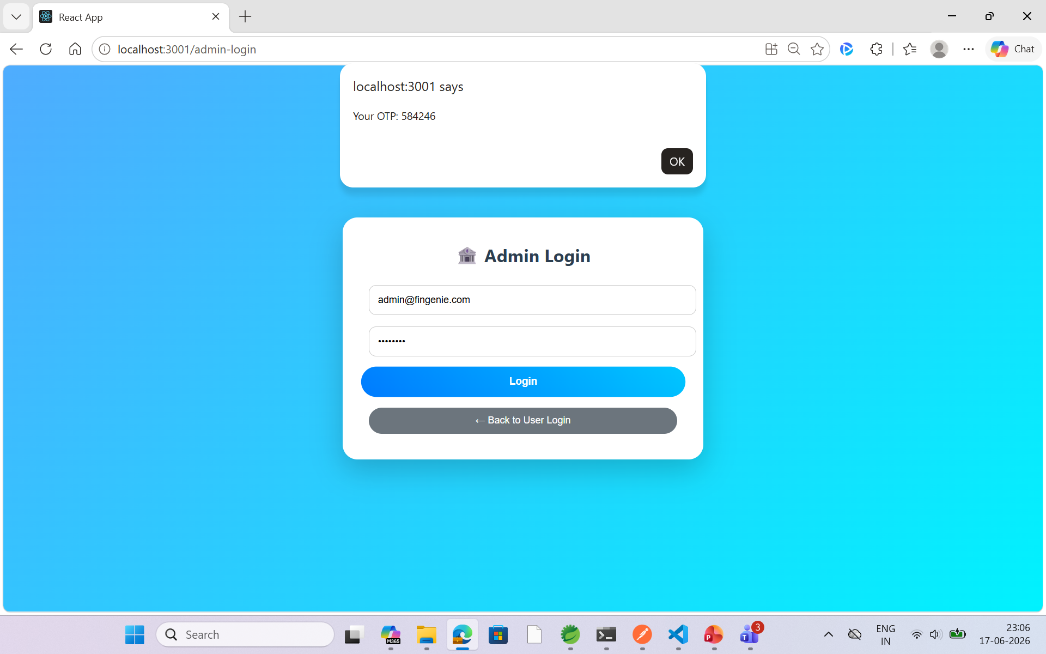
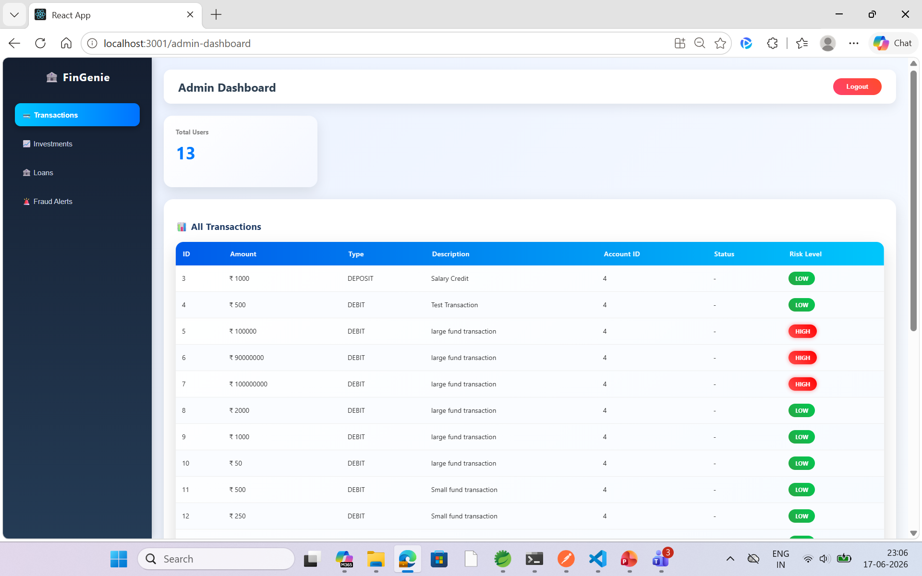
Admin Login Page Admin Dashboard

Slide 8
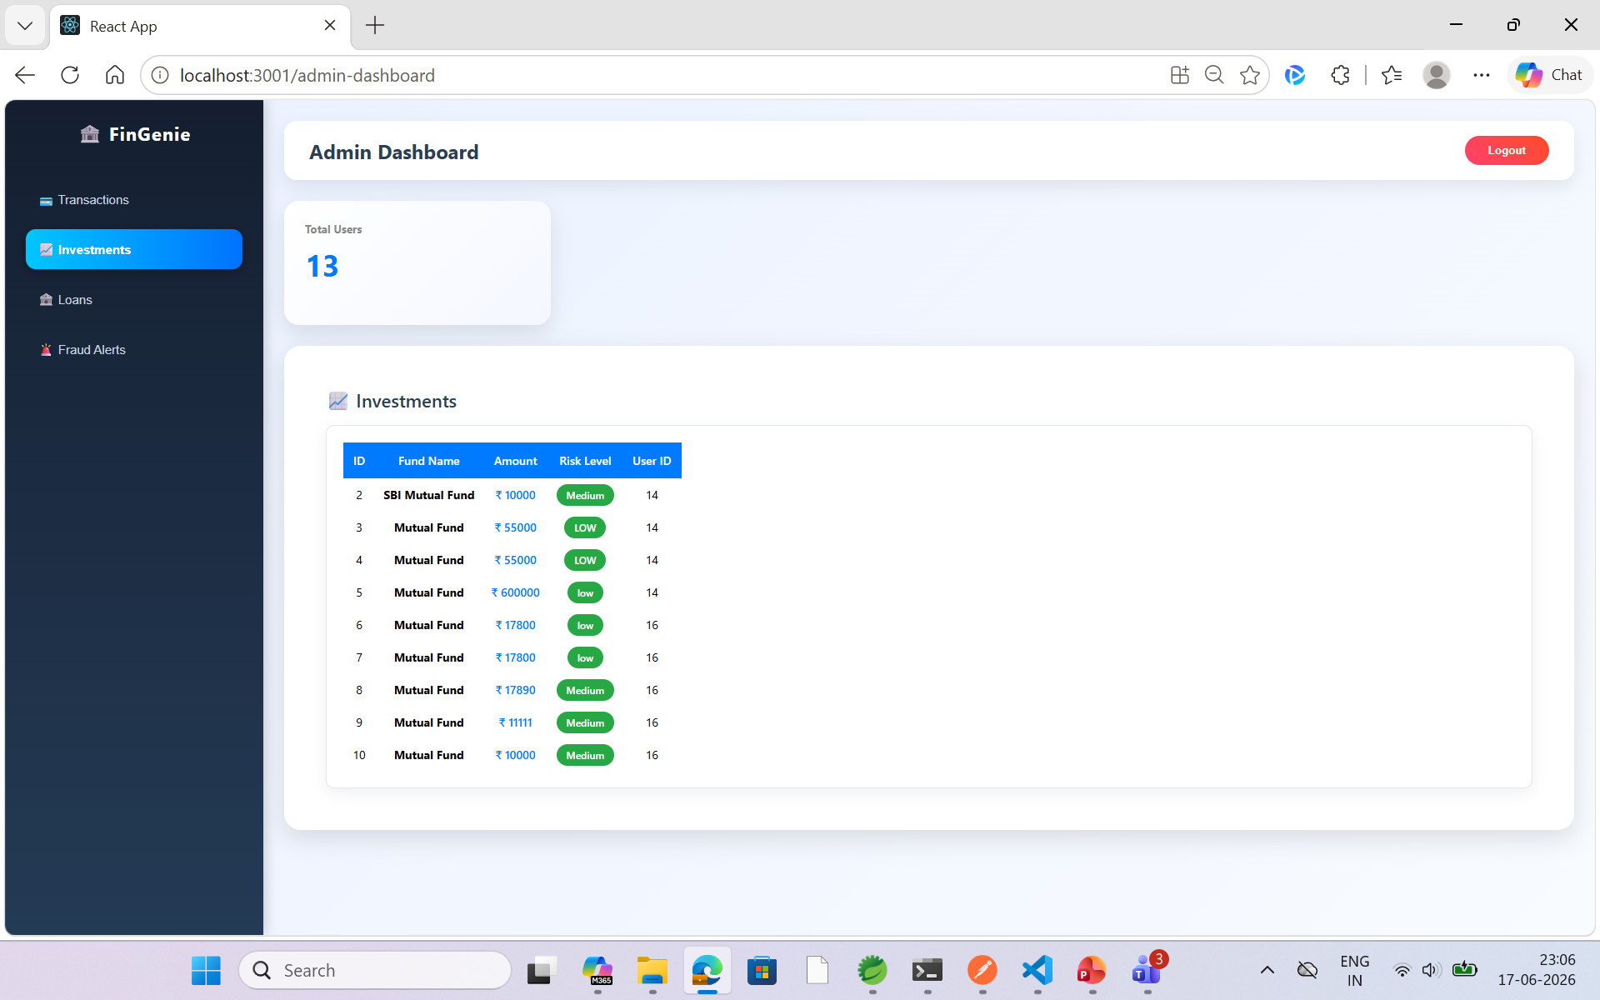
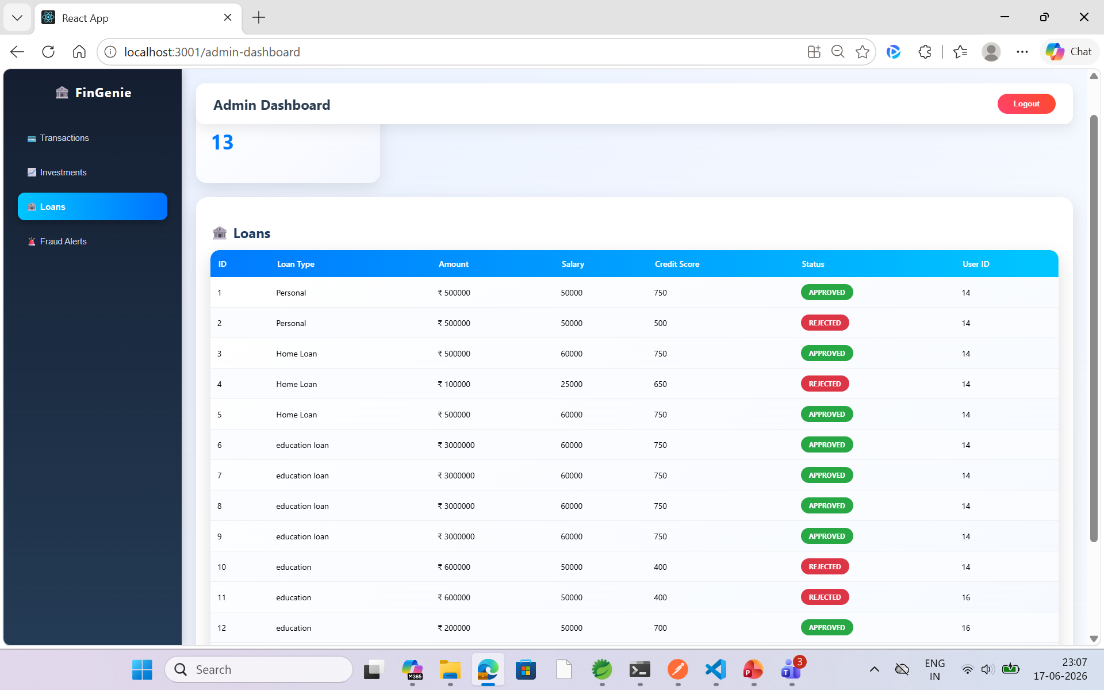
Investment page
Loan Page

Slide 9
Conclusion and Future Enhancement Developed a compute banking management solution. Improved banking security and user experience. Future Scope: Chatbot Assistant Advanced Analytics

Slide 10
THANK YOU

